Slide 1

The Unjournal (Unjournal.org)
We commission public evaluation, to make impactful research more rigorous & vice-versa
David Reinstein, Founder
unjournal.pubpub.org
@unjournal.bsky.social
Presentation for BITSS 2025
These slides: bit.ly/bitssunjournal
Notes:
I’m David Reinstein, an economist who was in university academia for 20 years. I left academia to pursue impact. I founded The Unjournal in mid-2023. We are not a journal; we don’t publish papers. We commission the public evaluation and structured rating of research in quantitative social science with the potential for global impact. This helps researchers focus on their research quality and helps policymakers and other researchers understand what research to use and how..
We aim to make impactful research more rigorous, to make rigorous research more impactful, and to support open science and innovation.
We have 2 FTEs, dozens more academics and researchers actively involved,
~35 detailed evaluation packages
Our biggest funder is Jan Tallinn via The Survival and Flourishing Fund.
2 FTE, ~20 active team members (mostly academics), 200+ people in our evaluator pool
[Again, we don’t publish papers. We we publish and disseminate evaluations and benchmarked ratings of research. so we make it easier for researchers to get feedback and credible assessment of their work, without having to navigate the opaque academic journal field].
See background (internal)

Slide 2
The Basic Case
From printed manuscripts to credible journal-independent evaluation
Separating evaluation from publishing unleashes a world of benefits
Much of this was covered by Brian Nosek
Initiatives in journal-independent,
public, structured expert evaluation
Unjournal: Our Approach
Our progress and our team
Get Involved
Notes:
In this lightning talk, l'll quickly go over why we thought there was a need for this [transparent, peer-reviewed evaluation of research, separate from journals]. Then I'll explain The Unjournal's basic process, our progress and growth, and I’Il end with a slide on how you can get involved,

Slide 3
The Basic Case

Slide 4

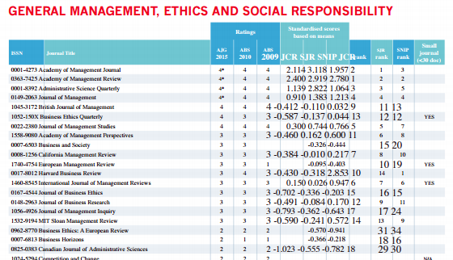

From printed manuscripts to journal-independent evaluation
IT made knowledge shareable
Working paper archives… freed us from journal monopolies over dissemination and curation
But evaluation, credibility and career capital are still locked in to those journals.
Notes:
We have the technical ability to publish to the whole world for free. With beautiful interactive, living, transparent-process formats. And we can communicate and give anonymous/public feedback instantly.
Tenure-Track criteria — Department of Economics
Considering these goals, the following may currently describe an average successful candidate: At least one article published in a top-5 general interest journal in economics (or equivalent in statistics or finance), reflecting the candidate’s quality of research and broader research agenda, and establishing the candidate as a leader in his or her field.
In addition, a number of published articles in top field journals and maybe further articles in lower ranked journals.

Slide 5
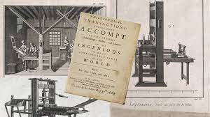
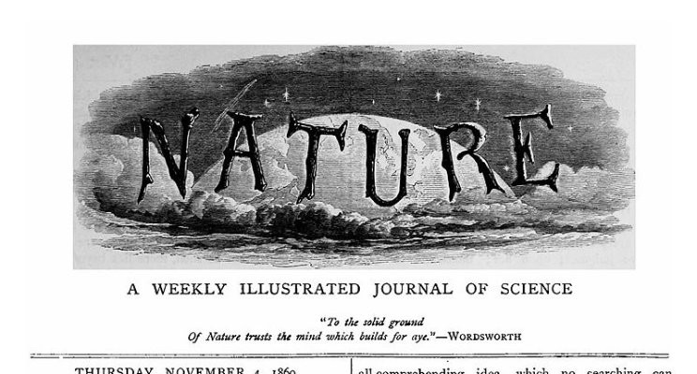
From printed manuscripts to journal-independent evaluation
As Brian Nosek pointed out
Notes:
The old system (which is to a large extent our current system) was built around a world of printed volumes and snail mail. These imposed a natural filter: access to a scarce resource (space in a printed journal), which was helpful. But it doesn’t need to persist we can rate, filter, and curate in other ways.
We now have the technical ability to publish to the whole world for free. With beautiful interactive, living, transparent-process formats. And we can communicate and give anonymous/public feedback instantly, and even use tools to help us ‘chat’ with readers.
But we haven’t moved on, in important ways. We’re still locked in by poorlycoordinated institutions and second-order beliefs and expectations – Academics “have to” publish in these journals (sometimes it’s even an explicit tenure criteria).
Our system is still based on legacy technology. You would never build it like this today. We can do better.

Slide 6
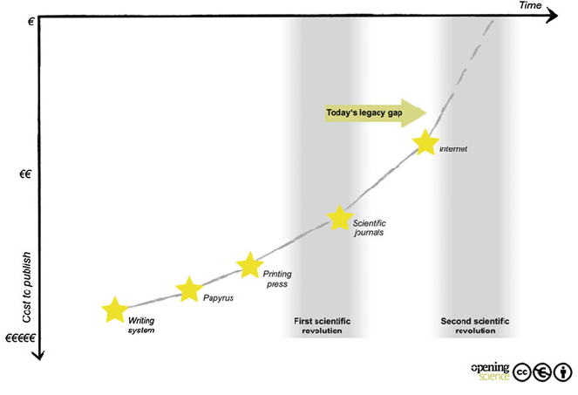

Slide 7
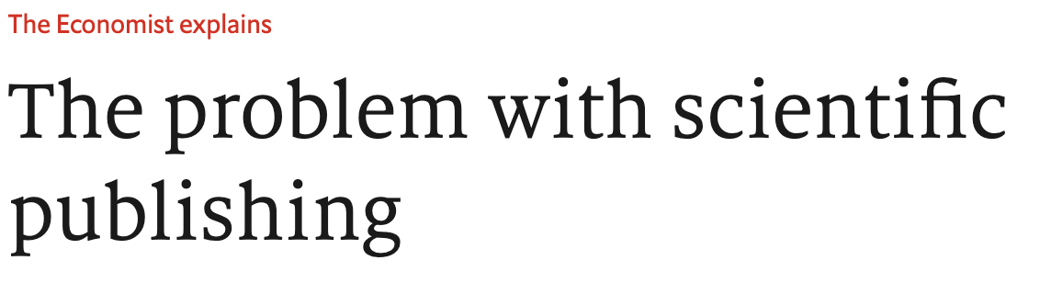
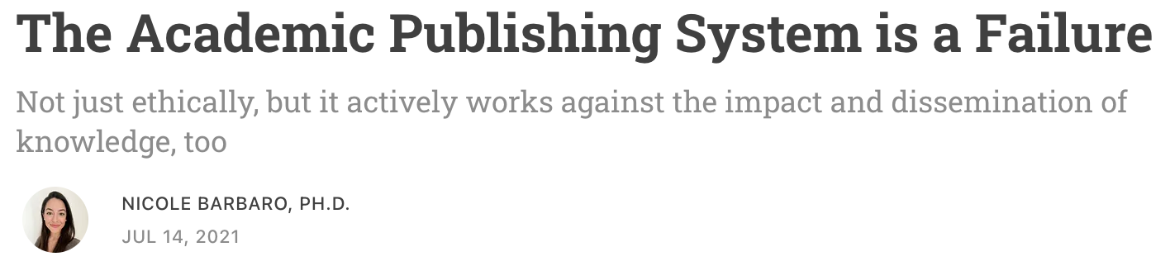
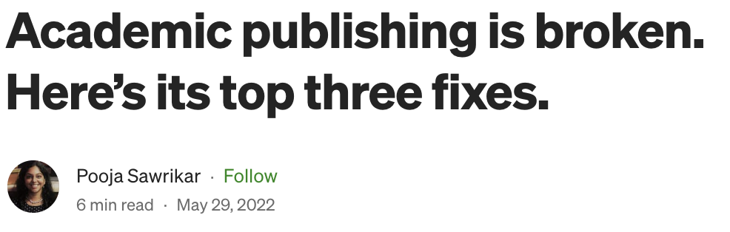
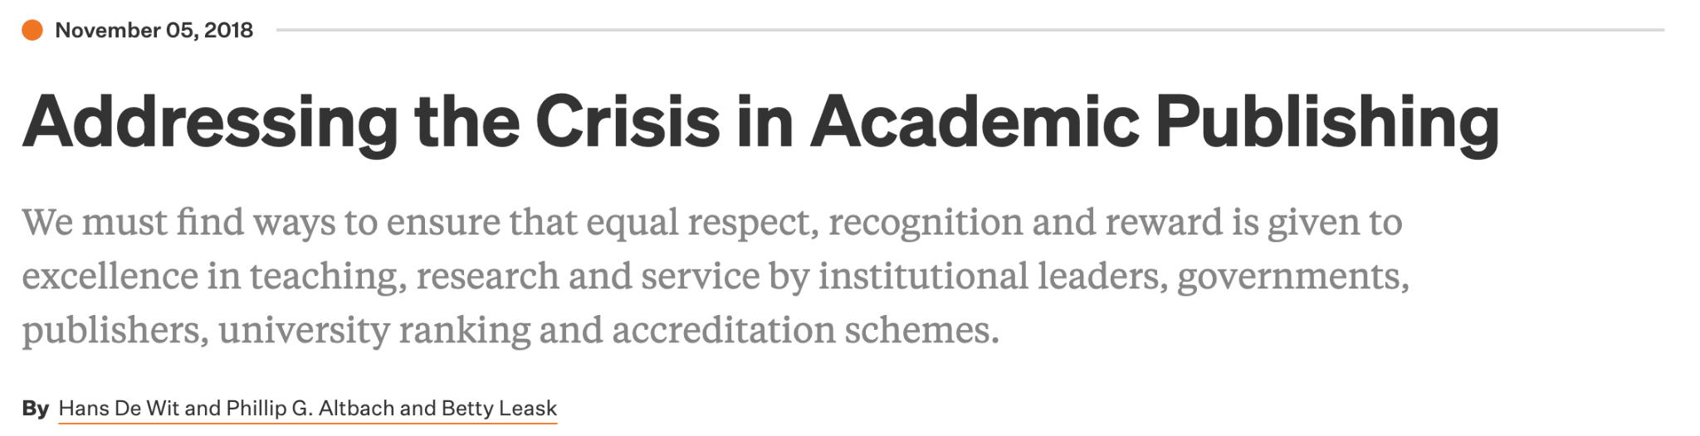



Notes:
People have a range of complaints – inefficiency, randomness, slowness, unfairness, rents, etc. Our approach solves some of these, we just need people to be willing to put their action where their mouth is.

Slide 8


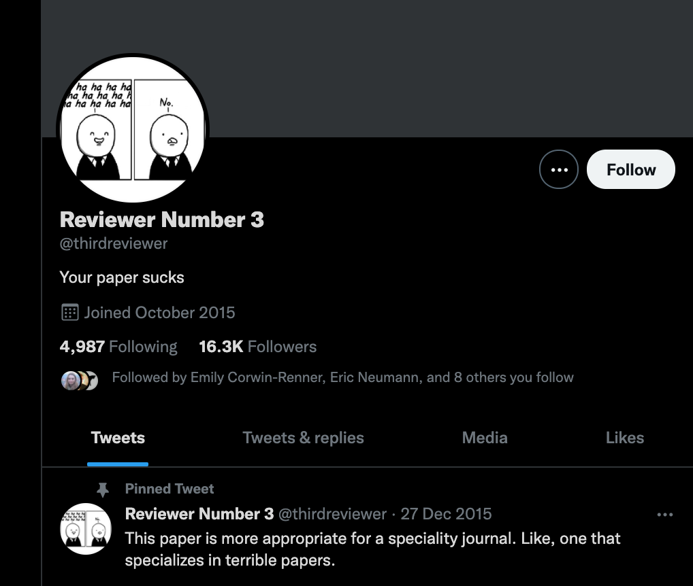
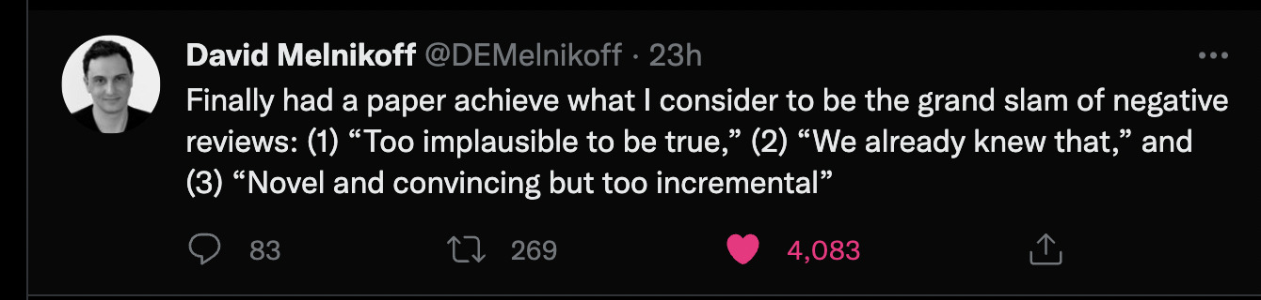
🔎: “Rejected after third revision”
Notorious “THIRD REVIEWER”
Rap stylings
Notes:
Just look on social media or talk to your colleagues. If you’re an academic, you already know this.
90% preaching to the choir. ”But we are stuck” they say.

Slide 9


Separating (public) evaluation and publishing unlocks a world of benefits
Open access
Evaluation across the research lifecycle (as noted by Brian Nosek, Lifecycle Journals)
Dynamic & transparent formats:
Supporting robustness, replication
Research conversations & AI facilitation ala econgoat
More informative assessment
Simpler “career value” → less game-playing
PDF prisons
Notes:
Open access: There is no need for journals to ‘own’ the research. We can reclaim ‘rents’ taken by for-profit publishers and intermediaries.
Open access also allows for public communication and reuse (hypothes.is, elicit.org, etc.)
Evaluation across the research lifecycle; not just one frozen ‘finished’ paper. We’re also supporting COS’ lifecycle journal on this.
Dynamic & transparent formats, such as dynamic documents via Quarto. We can evaluate these directly. This facilitates reproducible and transparent research practices
Decoupling allows for flexibility and innovation in general, rather than conservative journals and ‘page limits’. The journal ‘pdf prison’ is not the final product
We are already supporting replication efforts, e.g., evaluators suggest ‘what aspects merit computational reproduction, robustness-checking, replication’ and we pass this to i4replication. (or we can pay evaluators to do this themselves)
“More informative assessment” – see our output (previews are coming below)
“Simpler career value” – I think this is the biggest one…

Slide 10
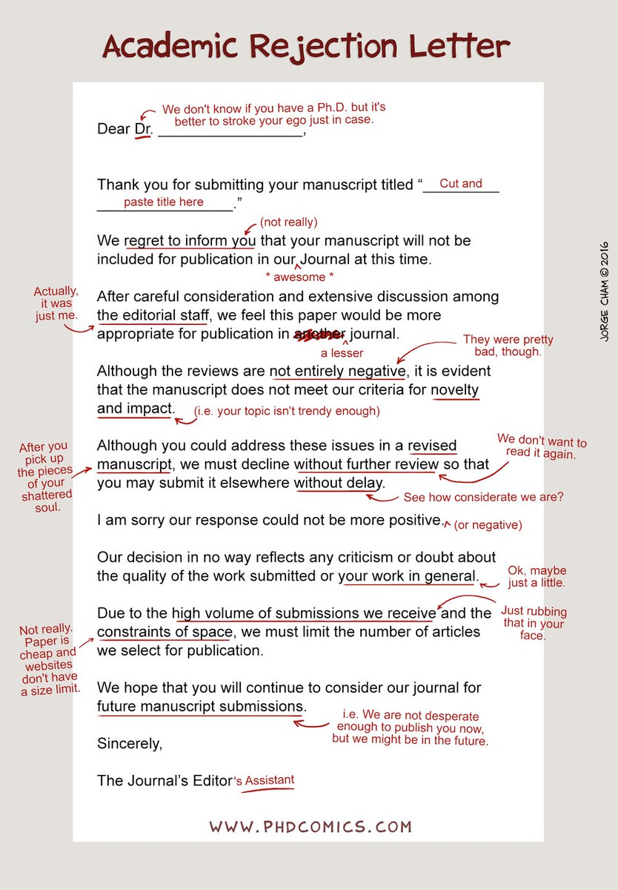
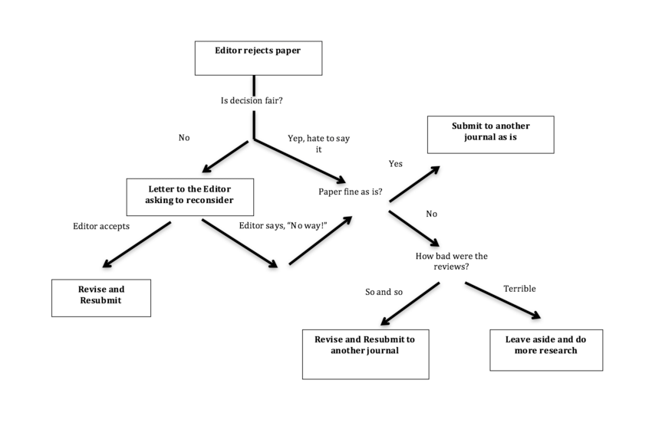
Benefits: Simpler “career value” → less gaming
This. Ad-nauseum, for years, dreaming & scheming…
OR

Slide 11
Benefits: Simpler “career value” → less gaming
Share publicly
Get prompt credible public evaluation
Get career rewards
[Optional] Improve research in situ, rinse and repeat
Not ‘salami slice off another paper’ → cleaner, more concise research record

Slide 12
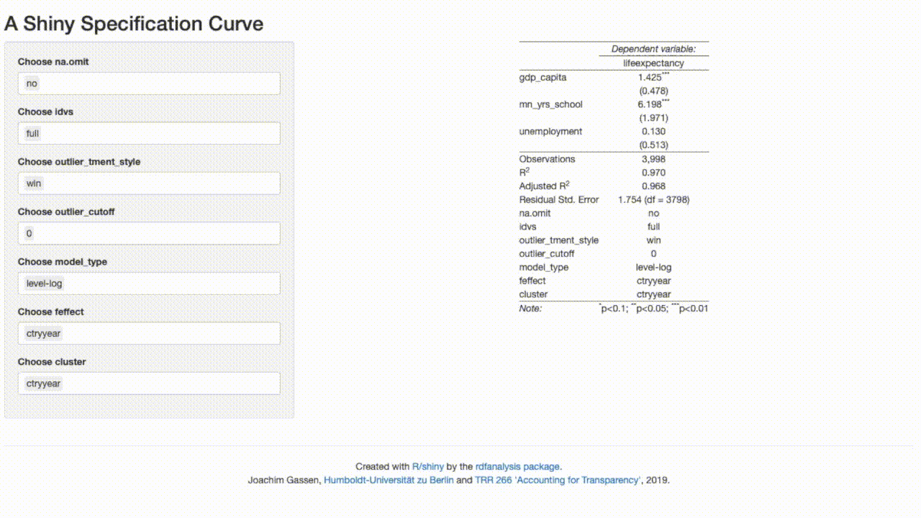
Benefits: Dynamic and transparent formats
Easy “multiverse analysis”
Notes:
These ‘multiverse analyses’ enable maximum robustness, and can replace hundreds of pages of appendices

Slide 13
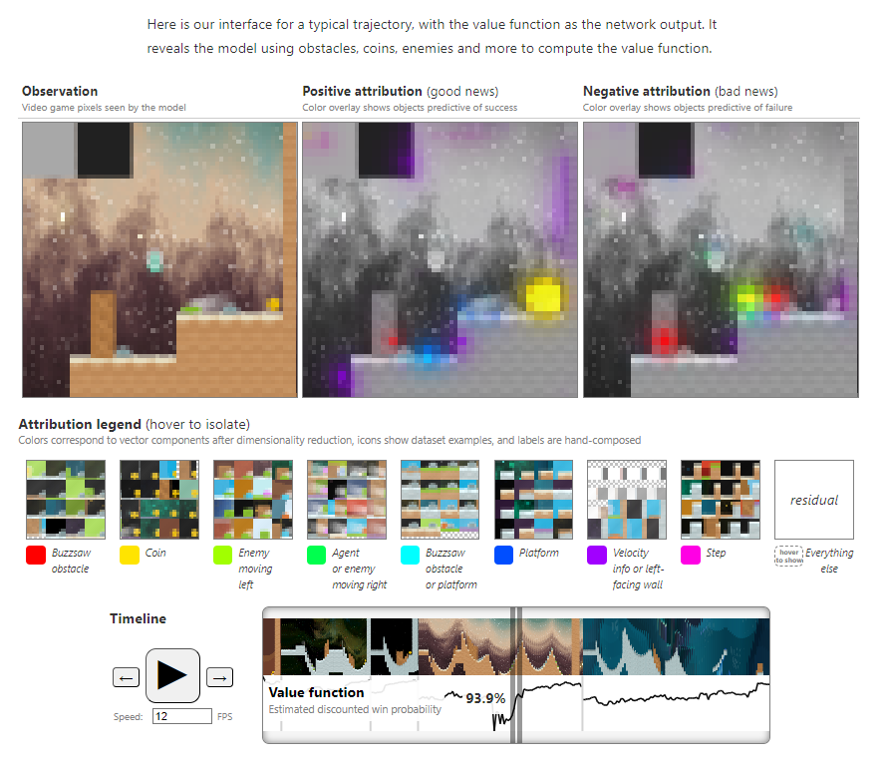
Interaction conveys so much more
Distill.pub: Understanding RL Vision

Slide 14
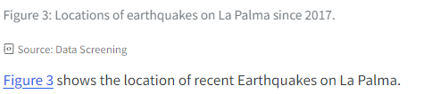

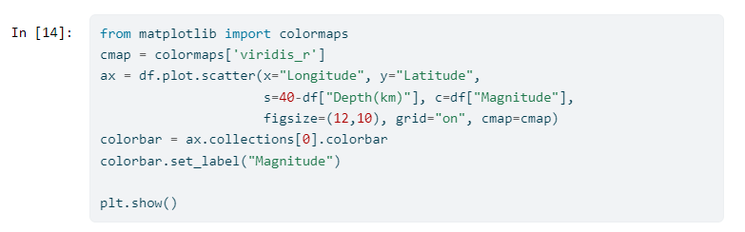
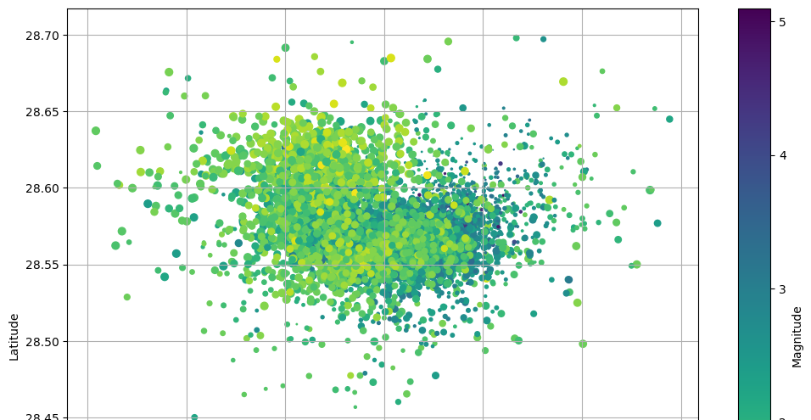
It’s all in one place
It builds itself right there
Transparent, checkable, replicable
Open the code and expand explanations … if you like
Quarto code+data notebook example: “La Palma Earthquakes”

Slide 15
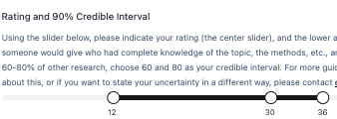
Benefits: Precise assessment
Overall percentile assessment
“Rank this relative to all serious research in the same area that you have encountered in the last three years.”
“Known-currency” ranking
“What journal ranking tier will this work be published in?”
“... should this work be published in?”
On a 0.0 - 5.0 scale explained with examples
See a version of our evaluator interface: bit.ly/UJevalacademic
Notes:
Better assessment: more precise, multi-dimensional, prompt, high-quality feedback and communication for researchers and research users
We give them sliders to rate the research (percentiles relative to a base group of research papers), and express uncertainty, in a range of categories. Some users might think “all I care about is whether the results as stated are likely to be true”
A precise calibrated measure
Not just ‘where it ended up’ in a confusing journal landscape
“please rank this paper relative to all serious research in the same area that you have encountered in the last three years. For example, choose 60% if you think this paper is better than 60% of such work.”

Slide 16
Benefits: Multi-dimensional assessment
“Advancing knowledge … to what extent does this contribute to the field…”
vs.
“Methods … well-justified and explained … reasonable approach … assumptions reasonable”
Notes:
Overall rating, categories like methodological rigor, practical/research advancements, logic and communication, relevance, connections and usefulness to real-world. And ‘what tier journal will [separately ‘should’] this be published in’?
Transparent processes
Emphasize rigor, robustness, communication over novelty & cleverness
Focus: global impact, economics and social science

Slide 17
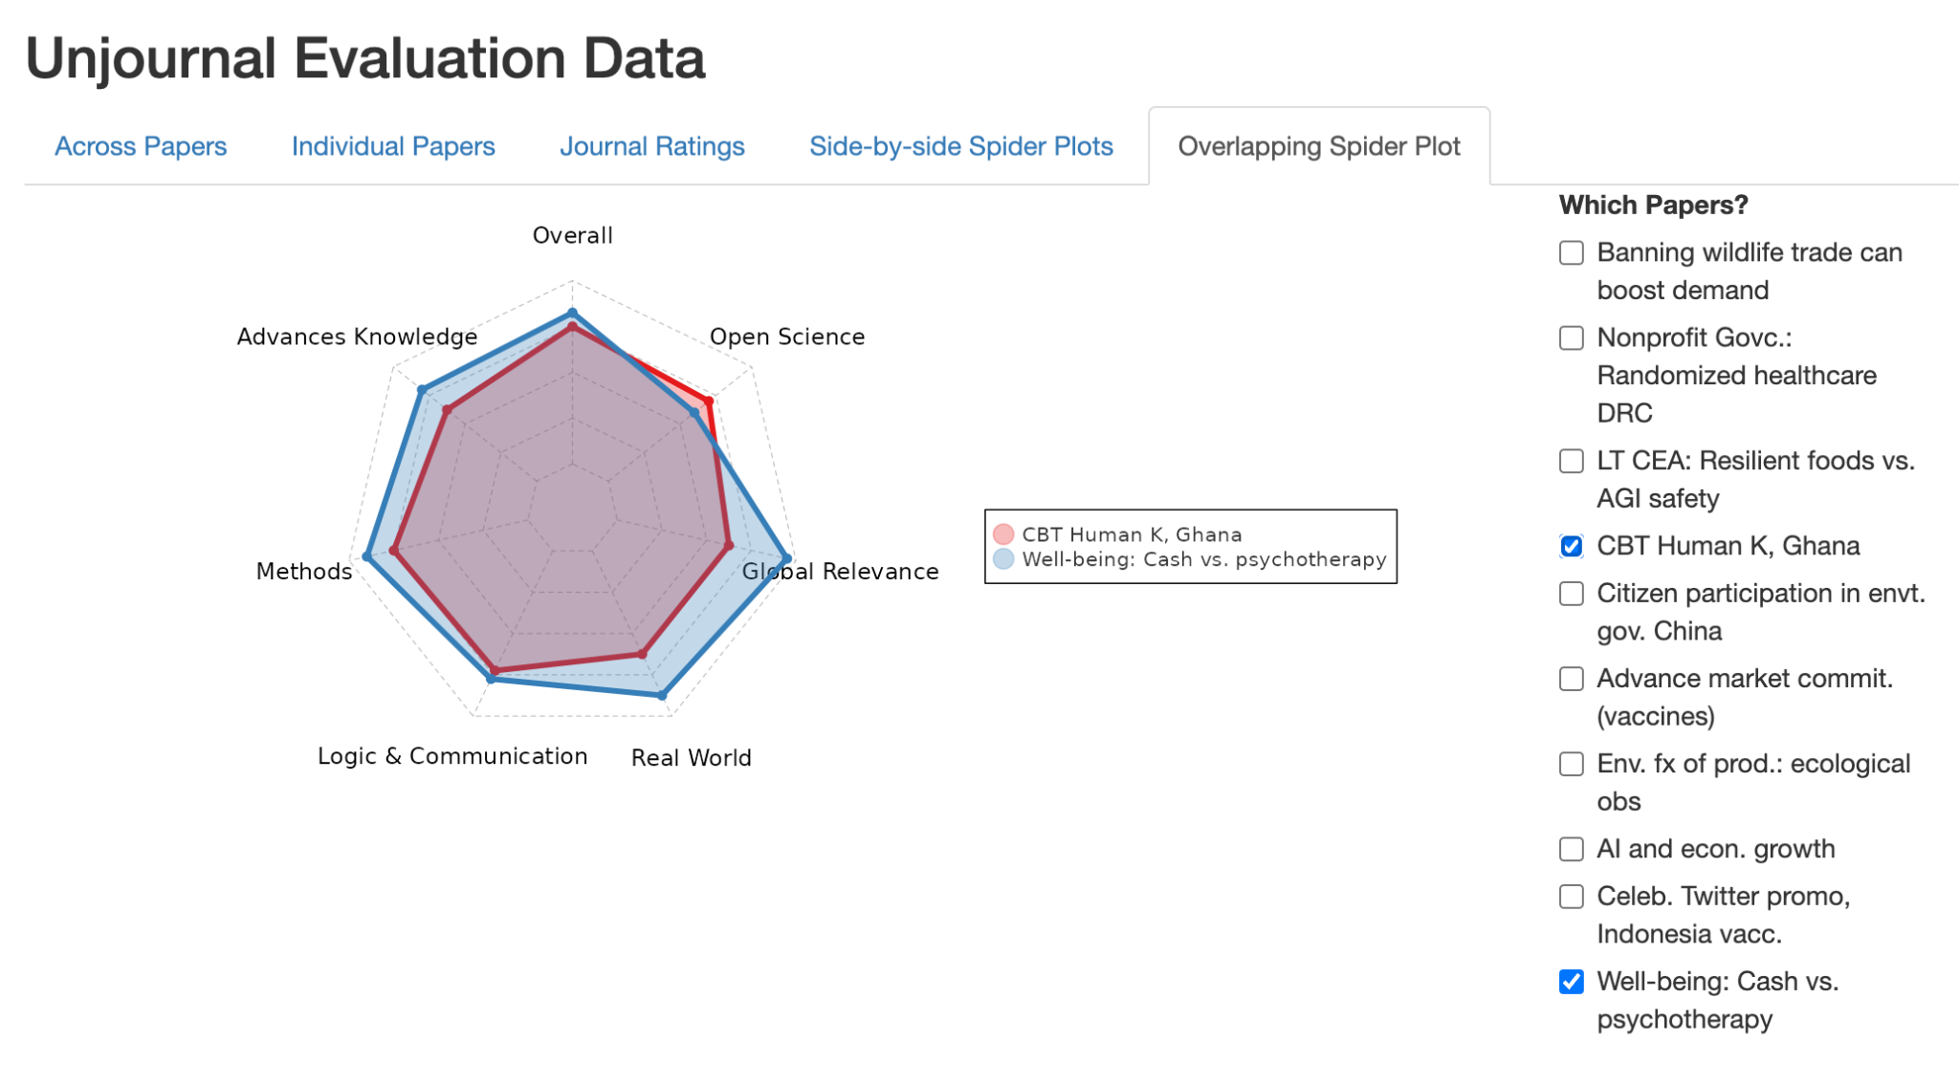
Public structured (as well as descriptive) evaluations
See: bit.ly/UJdashboard

Slide 18






Initiatives in ~journal-independent, public, ~structured evaluation
We’ve had conversations with each of these.
This is an old idea whose time has come.
Notes:
The Unjournal is trying a somewhat different approach, ‘proactively’ pushing forward with new resources, incentives, and organization; with a grant to specifically focus on globally-impactful research in economics and quantitative social science. [Tease our output here?].

Slide 19
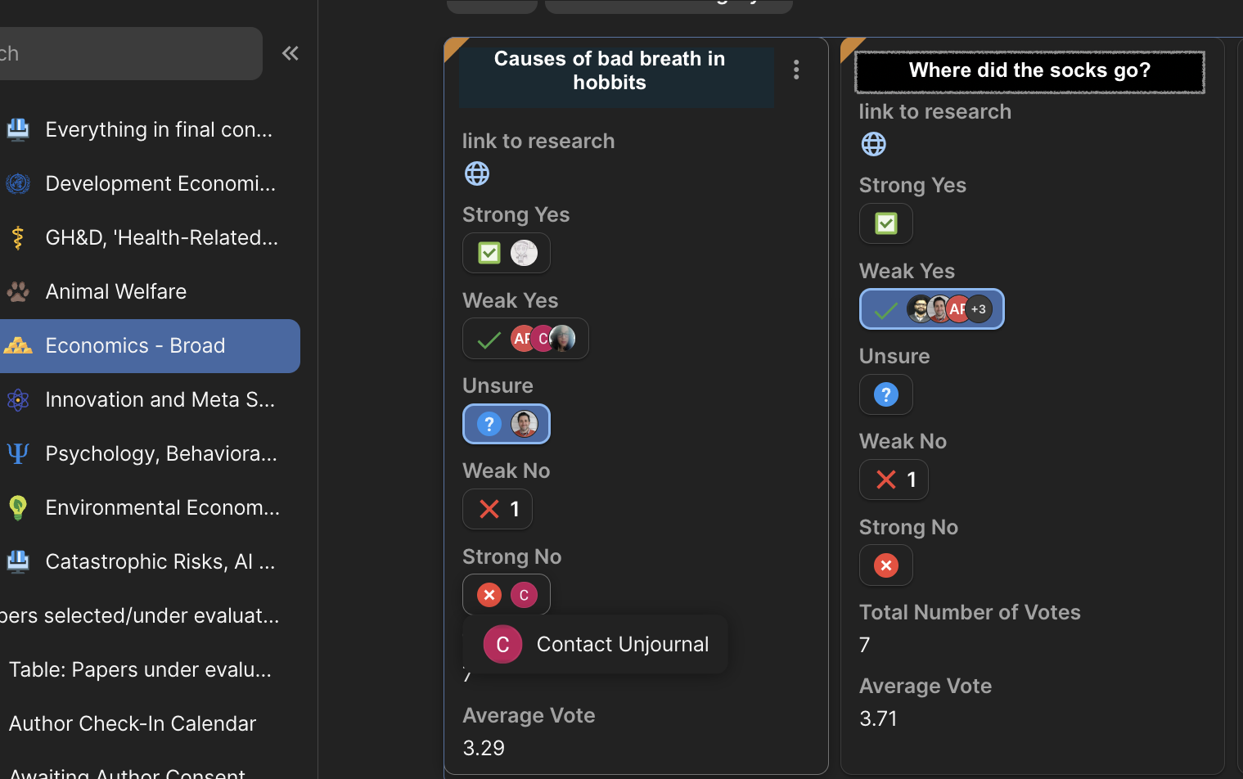
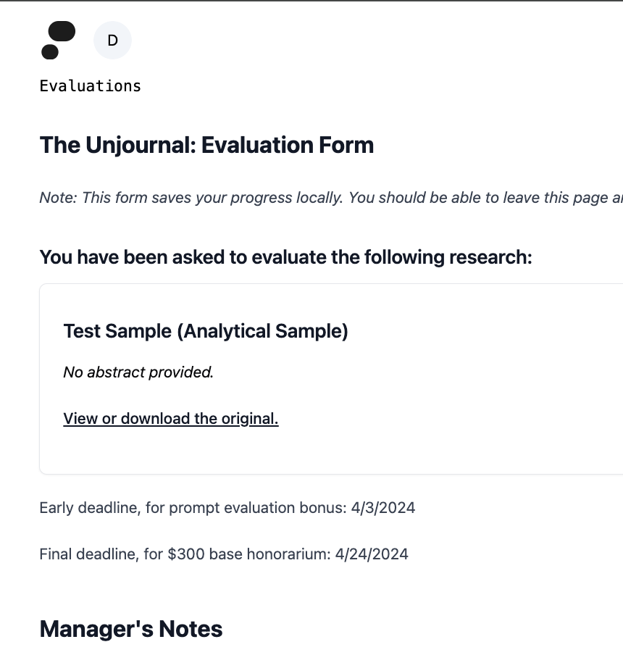
The Unjournal’s Basic Approach
Researchers submit or we select publicly-hosted work
Our team systematically prioritizes this (for impact potential)
Evaluation managers commission paid expert evaluators
Not exclusive:
We link the research
& publish the evaluation package
Notes:
Esp. “directly evaluating” papers in top WP series (NBER) as well as published but under-evaluated work
$450 average compensation, including incentives for strong and prompt work.
It’s a ‘bridge’. Authors can submit work to UJ and also traditional journals. This also enables benchmarking our ratings.

Slide 20
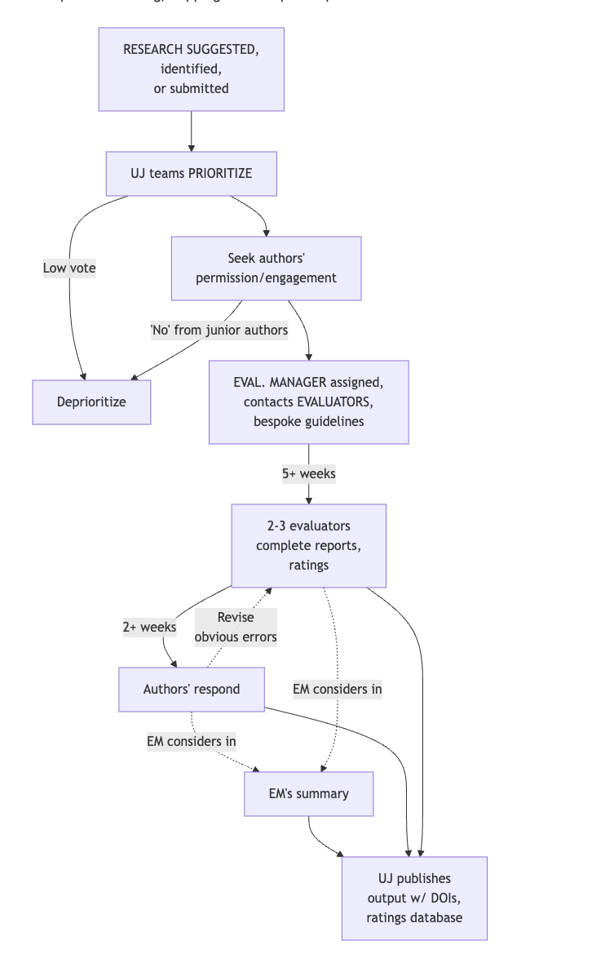
The Unjournal’s Basic Approach and Process
Map of our workflow:
bit.ly/UJworkflow
Our process, simplified

Slide 21
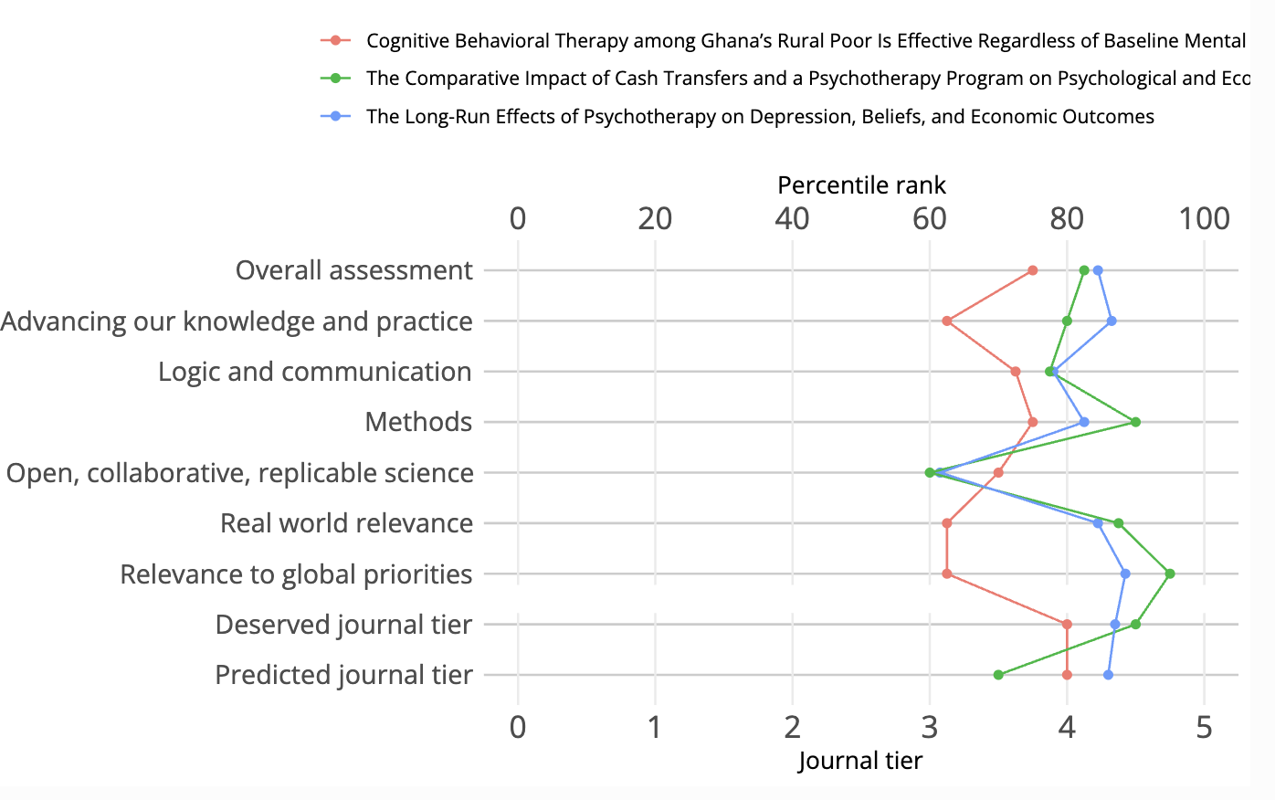
Unjournal’s Basic Approach - Metrics
We elicit quantifiable metrics and benchmark existing measures
as well as qualitative discussion
Notes:
Overall rating, categories like methodological rigor, practical/research advancements, logic and communication, relevance, connections and usefulness to real-world. And ‘what tier journal will [separately ‘should’] this be published in’?
Transparent processes
Emphasize rigor, robustness, communication over novelty & cleverness
Focus: global impact, economics and social science

Slide 22
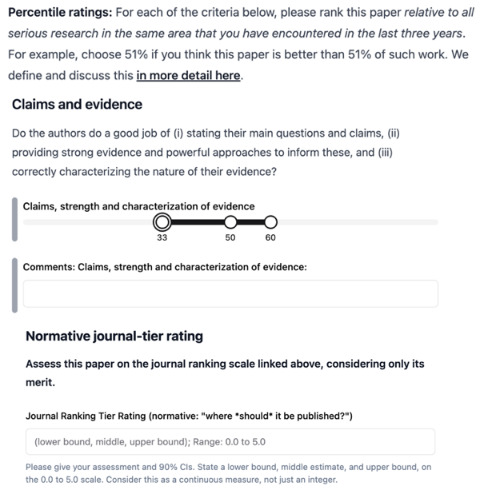

Slide 23
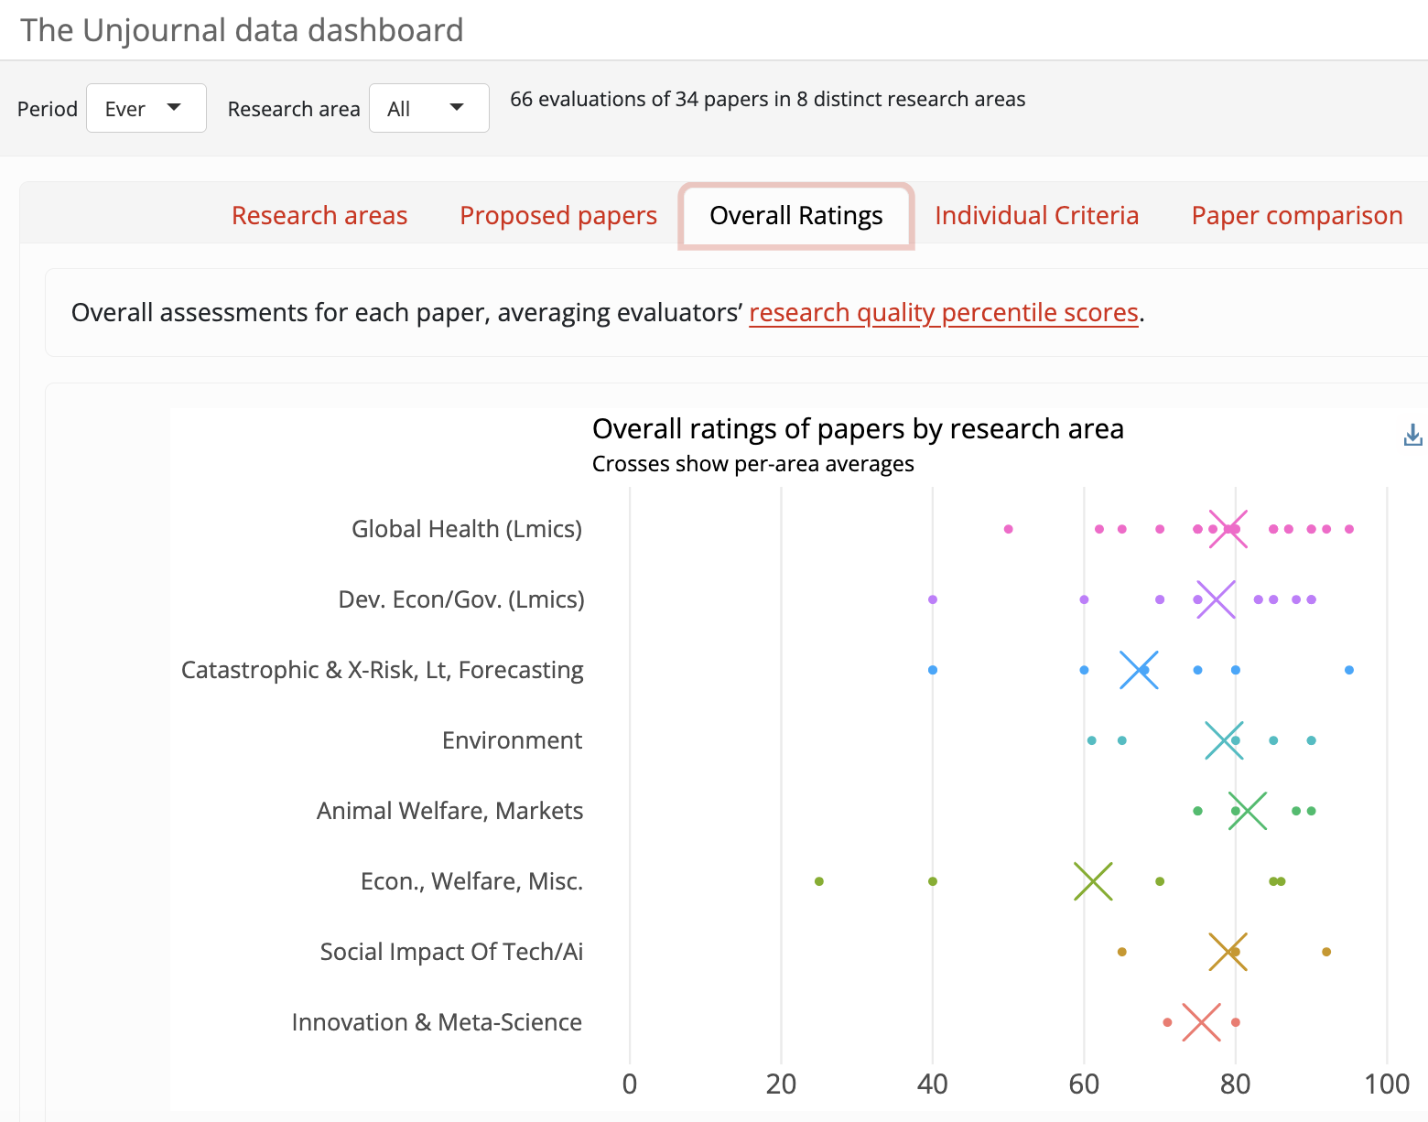

Slide 24
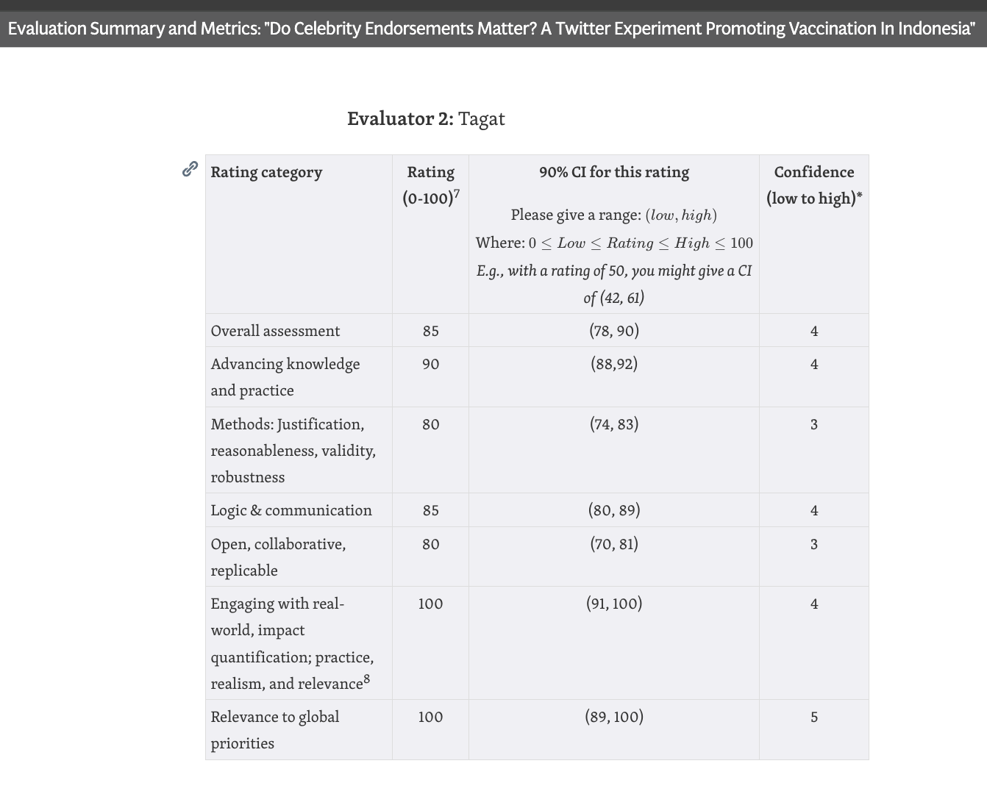

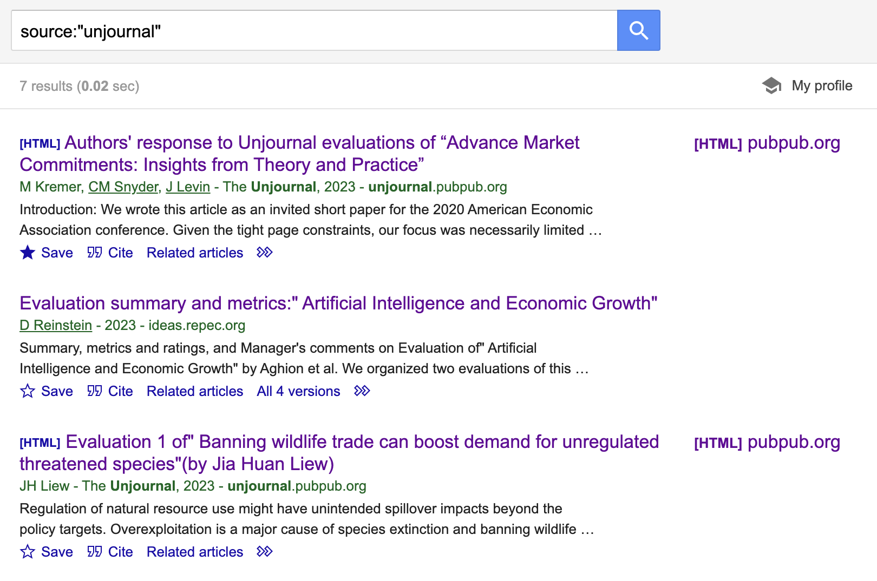
We make our output highly visible, linked to bibliometrics
See unjournal.pubpub.org

Slide 25
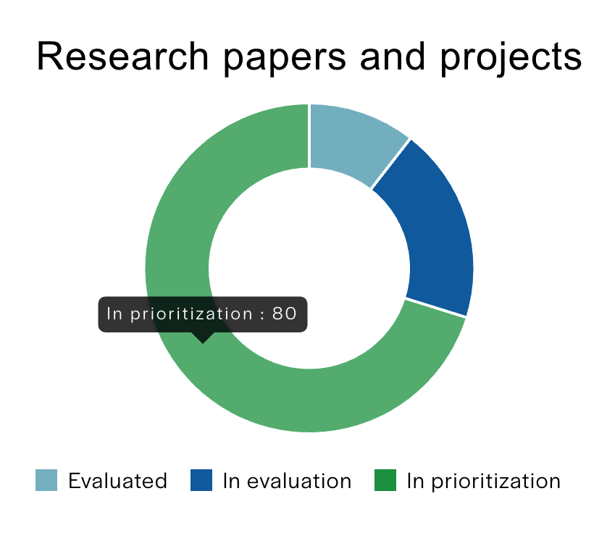
Our Progress
Unjournal.pubpub.org
Probably the strongest source of public ‘peer reviews’ in economics+
We got our hands dirty, we “know” what works
Pipeline & progress
By cause area/field
Building systems, feedback, improvements
Knowledge base, data dashboard
PubPub hosting, public prioritization database, evaluation management systems, interface
Expanding our team
Notes:
Cultivating links with Knowledge Futures, COS, Effective Thesis, PREreview, Institute for Replication, Replicats, IGDORE, BITSS, …

Slide 26
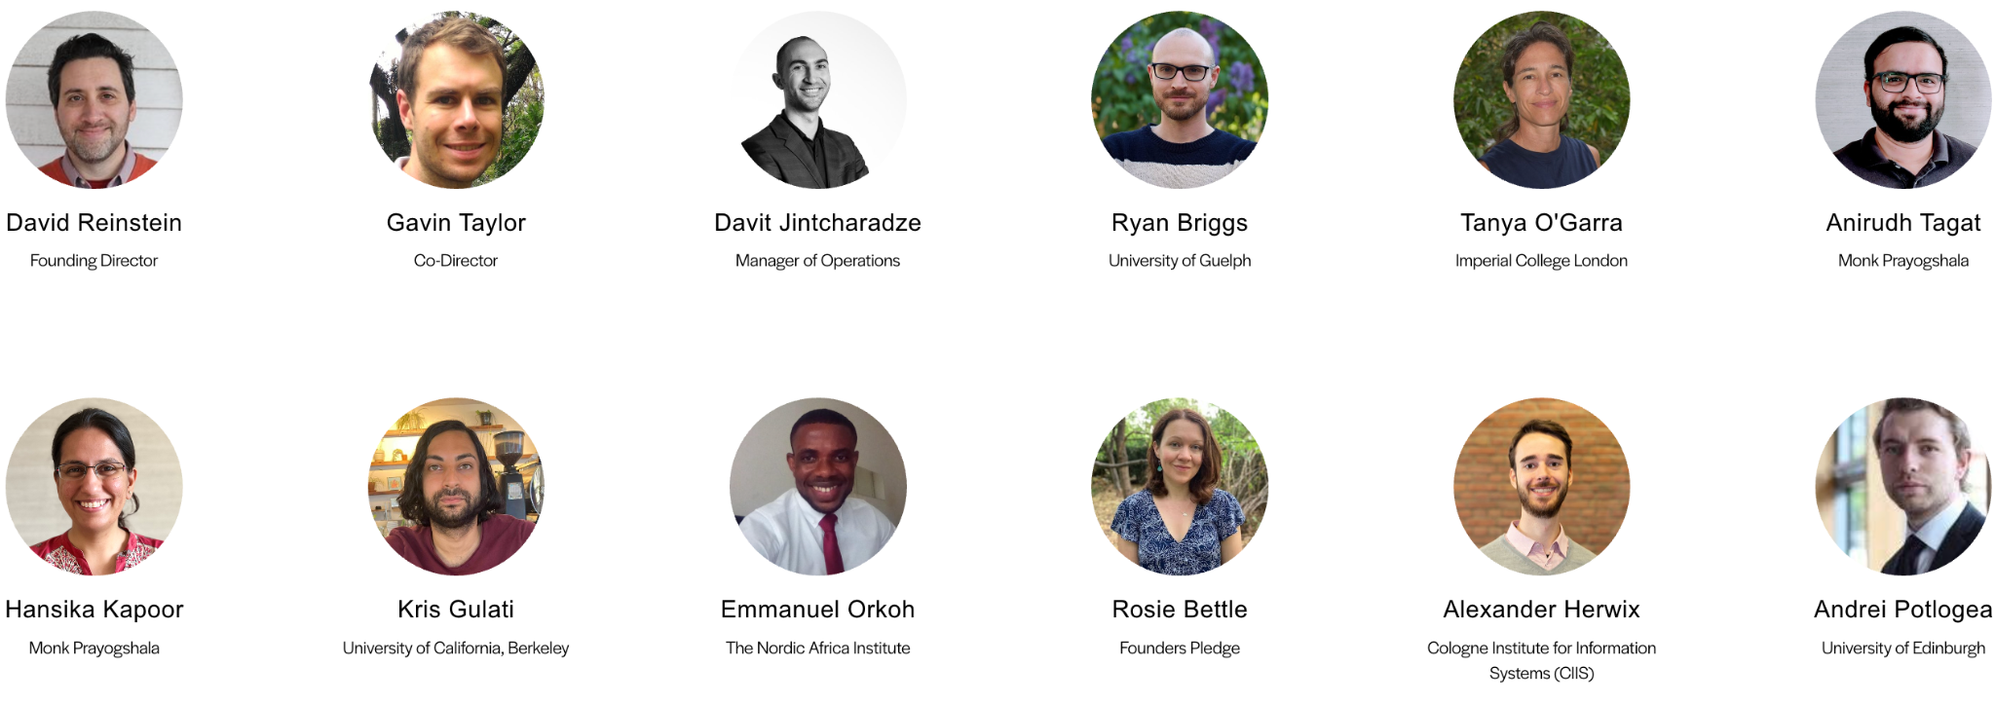



Our Team - Management, Advisory Board

Slide 27
Field specialist teams, evaluator pool
Field specialists
Development economics: Anirudh Tagat, Ryan Briggs, Michael Wiebe, Nathan Fiala, Emmanuel Orkoh, Nathan Fiala, Robert Kubinec, Masyhur Hilmy, Wayne Sandholtz, Lee Crawfurd
Global health and well-being: Jake Eaton, Rosie Bettle, Charlotte Lane, Shobhit Kulshreshtha, Jonah Goldberg, Valentin Klotzbücher, Priya Lall
Economics, welfare, and governance: David Reinstein, Julian Jamison, Tabare Capitan, Joel Christoph, Andrei Potlogea, Greg Sasso
Psychology, behavioral science, attitudes: Hansika Kapoor, Jonathan Berman, Mattie Toma, Carina Ines Hausladen, Hannah Metzler
Innovation, meta-science, social impact of technology: Daniela Cialfi, Jordan Dworkin, Kris Gulati, Andrew Kao, Gavin Taylor
Environmental economics: Tanya O'Garra, Ben Balmford
Animal welfare (markets, attitudes): Josh Tasoff, Kevin Kuruc, Florian Habermacher, Nicolas Treich
Catastrophic risks, AI governance and safety: David Manheim; advisory: Anca Hanea, Alexander Herwix
Evaluator pool: ~200 signups
Over half are economists, over half have doctorates

Slide 28

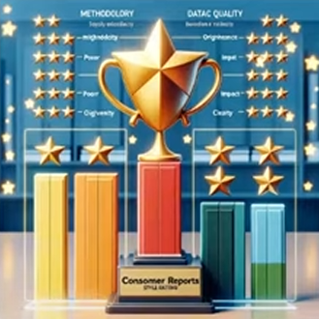
Our main challenges
Coordination:
collective-action problem
Generating credibility and value without journals
Notes:
As I’ve suggested, this is a collective action problem. I’m happy to chat about our approaches to cracking this one, and our progress.
We’re also working to benchmark our ratings and ‘have our evaluations evaluated’.
Moved – See discussion space: “... How & why will this succeed or fail?”
See discussion space: “Structured evaluation metrics: (How) should we rate research?”

Slide 29

Get Involved
Submit your research: bit.ly/UJsubmit
(or to lifecycle journals → Unjournal)
Join our team: bit.ly/joinujteam
As a paid evaluator (~$450 average with incentives, aiming to increase)
or Research Affiliate, Field specialist, Advisory Board, or Management Team member.
Engage
Read, cite, and use our evaluations & ratings
Share your feedback and help us improve
Sign up to be a part of the new system
Orgs: Consider collaborating
Encourage your students to take the leap
How to get involved: bit.ly/joinujteam
These slides: bit.ly/bitssunjournal
Notes:
You can help us solve the Collective Action Problem: “Sign up”; take visible steps to identify yourself as ‘part of the new system’;
early-adopters will be rewarded. Spread the word.
E.g., consider submitting your research to The Unjournal,
Join our team/orbit
Join our evaluator pool (paid evaluation
Become a field specialist or Unjournal Research Affiliate; suggest work for us to evaluate, hel[ us prioritize it
Our management team, advisory board
We are building tools and systems → apply these to other fields and areas
We welcome your feedback and opinions

