Slide 1
Forecasting Social Science: Evidence from 100+ Projects
Stefano DellaVigna, UC Berkeley and NBER
Nicholas Otis, UC Berkeley
Eva Vivalt, University of Toronto
BITSS Annual Meeting
February 27th, 2025

Slide 2
Forecasts of Research Results
Growing interest in forecasts of research results
Over 100 papers collect forecasts and compare them to results
Important for gathering of evidence:
Are researchers over-optimistic about effect sizes?
Are practitioners more so?
Important for interpretation of evidence (DellaVigna, Pope, and Vivalt, 2020):
Measure updating relative to priors
Mitigate publication bias against null results

Slide 3
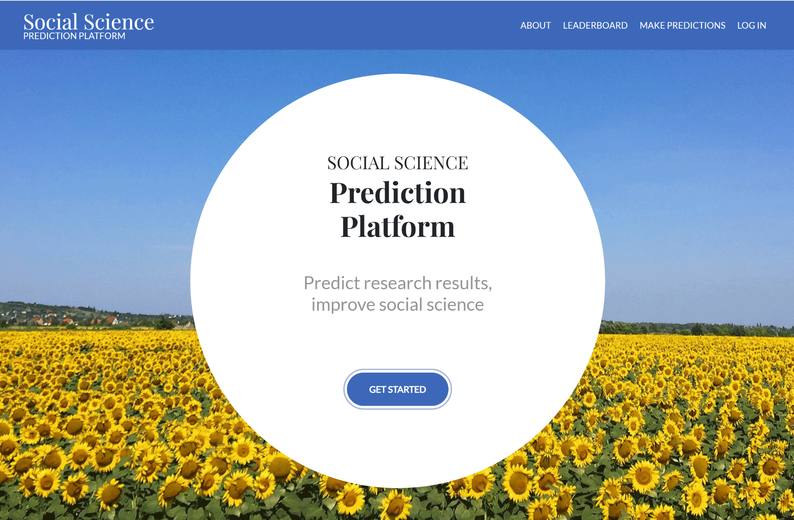
Forecasts of Research Results
This paper: All projects on only forecasting platform, SSPP
106 projects, 899 key questions
73 projects are about treatment effects, 47 about summary statistics
59 projects with posted results
3,303 unique forecasters and 47,616 forecasts of key questions

Slide 4
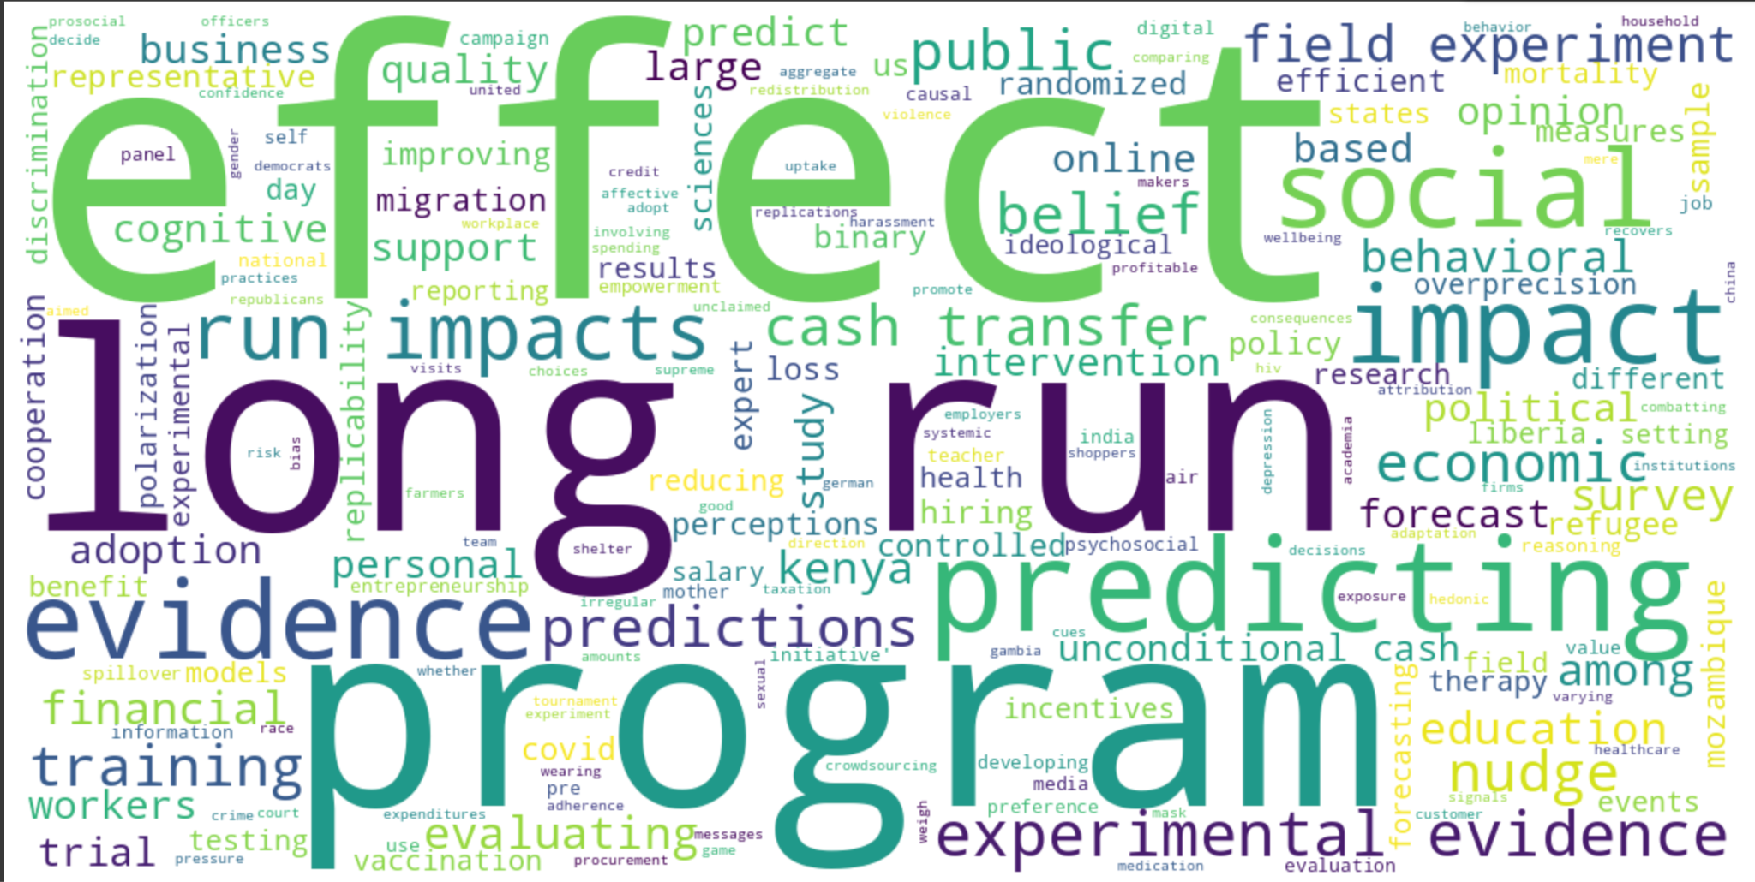
Forecasts of Research Results
Projects covering:
Economics - Development economics (36), Behavioral/experimental economics (48), Other economics (14)
Political Science (11)
Psychology (18)
Word cloud of project titles

Slide 5
Forecasts of Research Results
What is existing evidence?
Title | Predictand | N studies | N forecasters | N forecasts | Forecaster attributes | Cross-study accuracy | Confidence | Wisdom of crowds
The SSPP | Exp. effect (in s.d.) Summary stat. (in s.d.) | 59 (106) | 2,189 (3,303) | 28,305 (47,616) | Yes | Yes | Yes | Yes
Camerer et al., 2018 | Replication probability (continuous [0,1]) | 21 | 211 | N/A*(Pred. market) | No | No | No | No* (Market vs ind.)
DellaVigna and Linos, 2022 | Experimental effect (in ppt) | 14 | 237 | 3*237 | Yes | No | No | No
Otis and DeVaan, 2023 | Experimental effect (in s.d.) | 6 | 681 | 4,528 | No | No | No | No
Bernard and Shoenegger, 2024 | Experimental effect (in s.d. [and more]) | 7 | 91 Academics | ≈4,600 | Yes | No | Yes | Yes
Ashokkumar et al., 2024 | Experimental effect (in s.d. [and more]) | 9 | Not provided | Not provided | No* (Experts vs laypeople) | No | No | No
Milkman et al., 2022 | Experimental effect [in ppt] | 1 | 24 Scientists | 528 | No* (Experts vs laypeople) | No | No | No
Notes:
Nick: 4 papers predicting experimental effects, 3 predicting replicability. Include papers predicting many treatments in a megastudy? Create table for us to see and we can decide whether or not to include it.

Slide 6
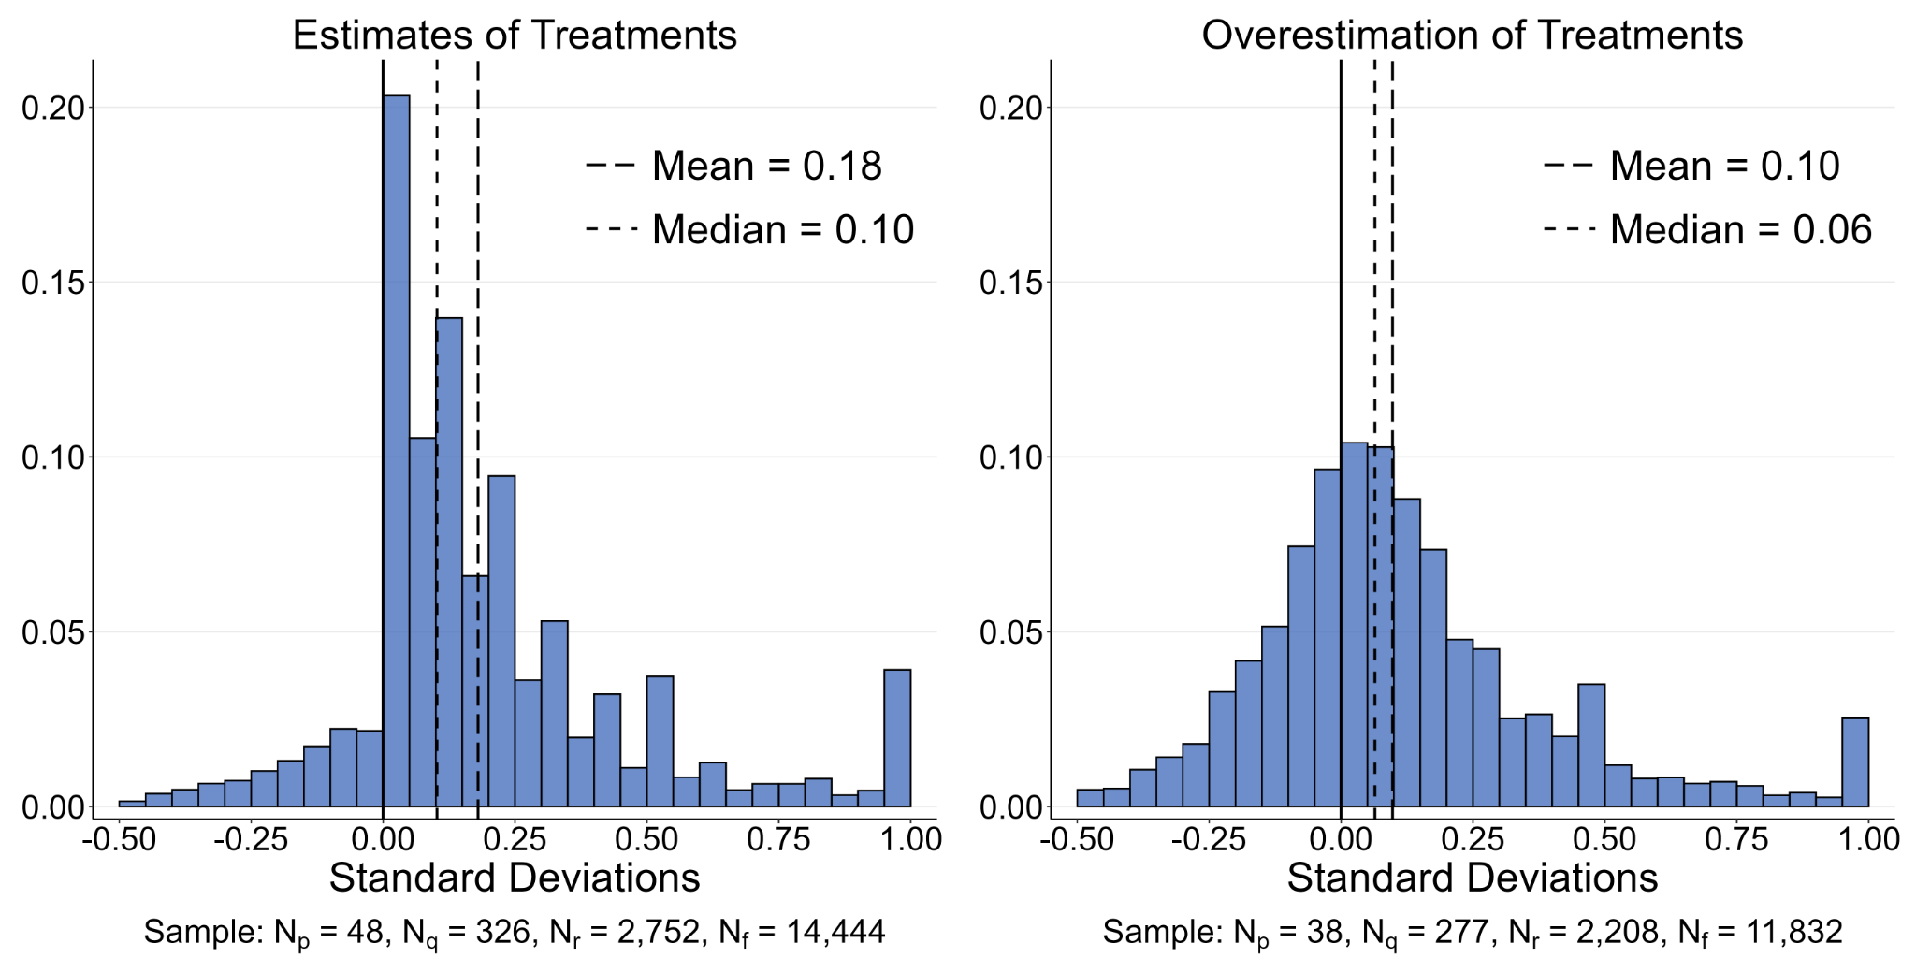
Forecasts of Research Results
Study two key outcomes
Treatment Effect Forecasts. RCTs and not, effect size in s.d., standardize direction. What do people expect? Are they right?
Notes:
This is the first result - this is how forecasts and treatment effects compare. Want to change the visual: Create a distribution of what effect sizes are and what the results are. Try a PDF, not a CDF.

Slide 7
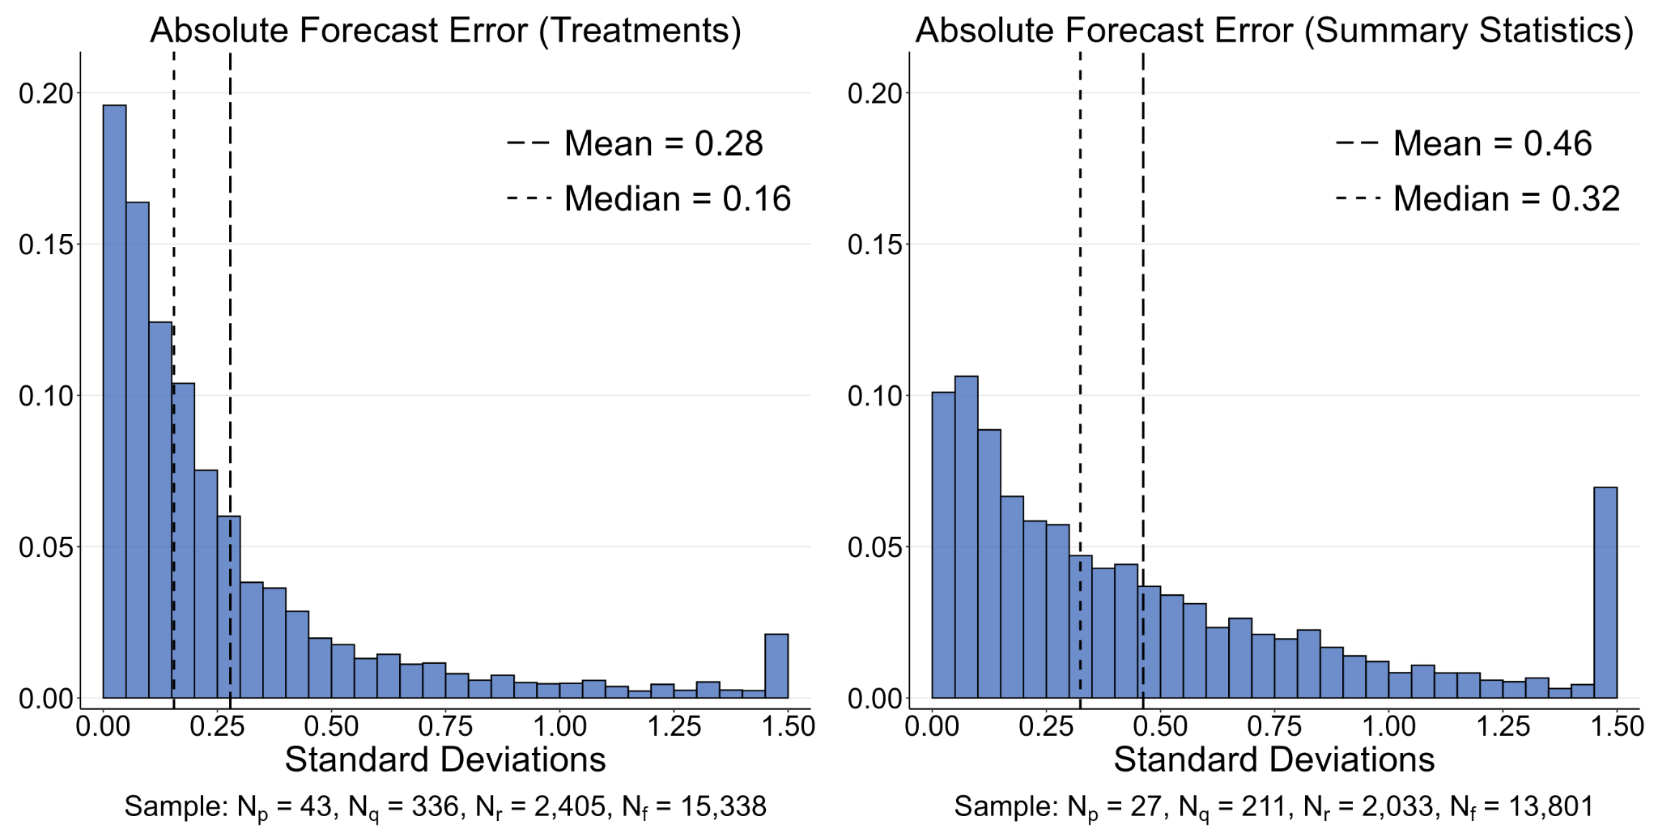
Forecasts of Research Results
Study two key outcomes
Absolute Error in Forecast. 59 projects with recorded results (RCTs and not), standardize by s.d. and compute absolute error

Slide 8
Forecasts of Research Results
Study five key questions:
Non-academics vs. academics:
Do they hold systematically different beliefs?
Knowledge and expertise:
How much does expertise matter?
Academics, study in same field and subfield
Confidence:
Do people have correct beliefs about accuracy?
→ Does confidence in forecast indicate accuracy?
Superforecasters: Are there superforecasters?
Wisdom of Crowds: How much does it improve accuracy?

Slide 9
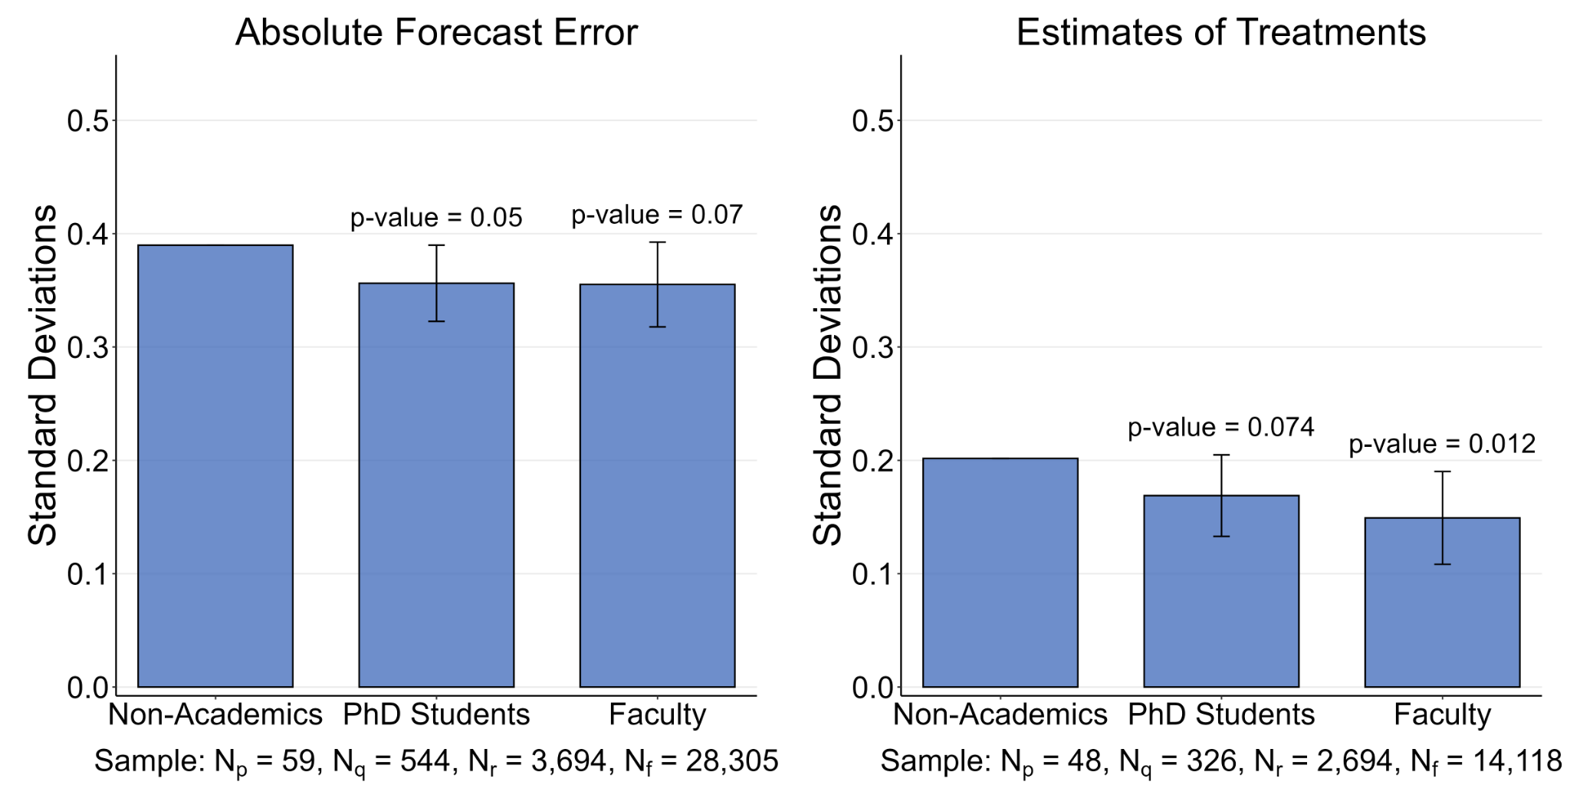
Non-Academics vs. Academics
Non-academics vs. academics
Do they hold systematically different beliefs?

Slide 10
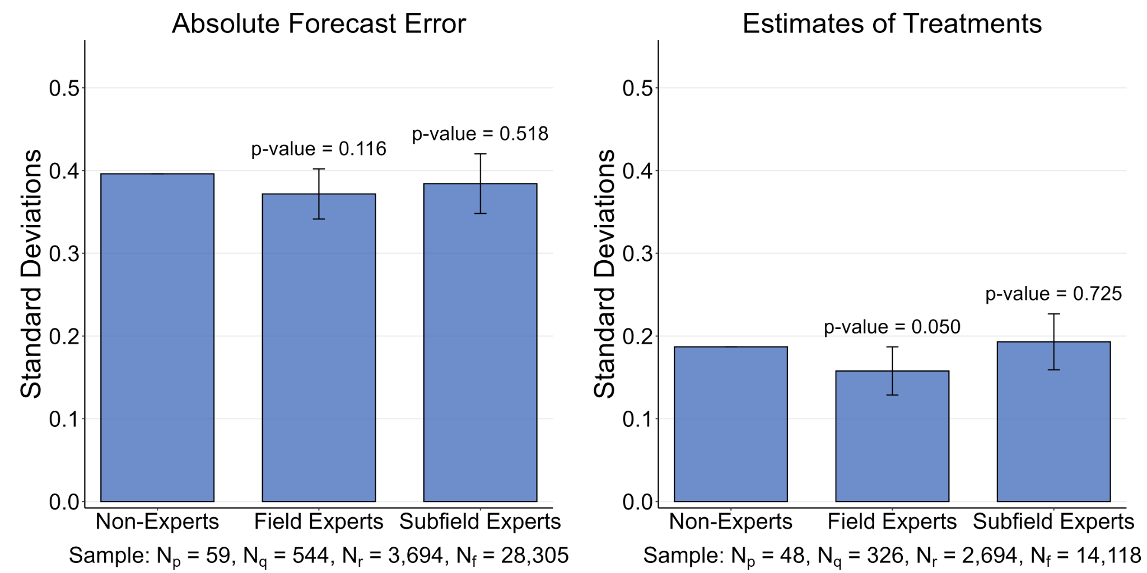
Field Knowledge
Knowledge and Expertise
Does it matter to be in field? In subfield?

Slide 11
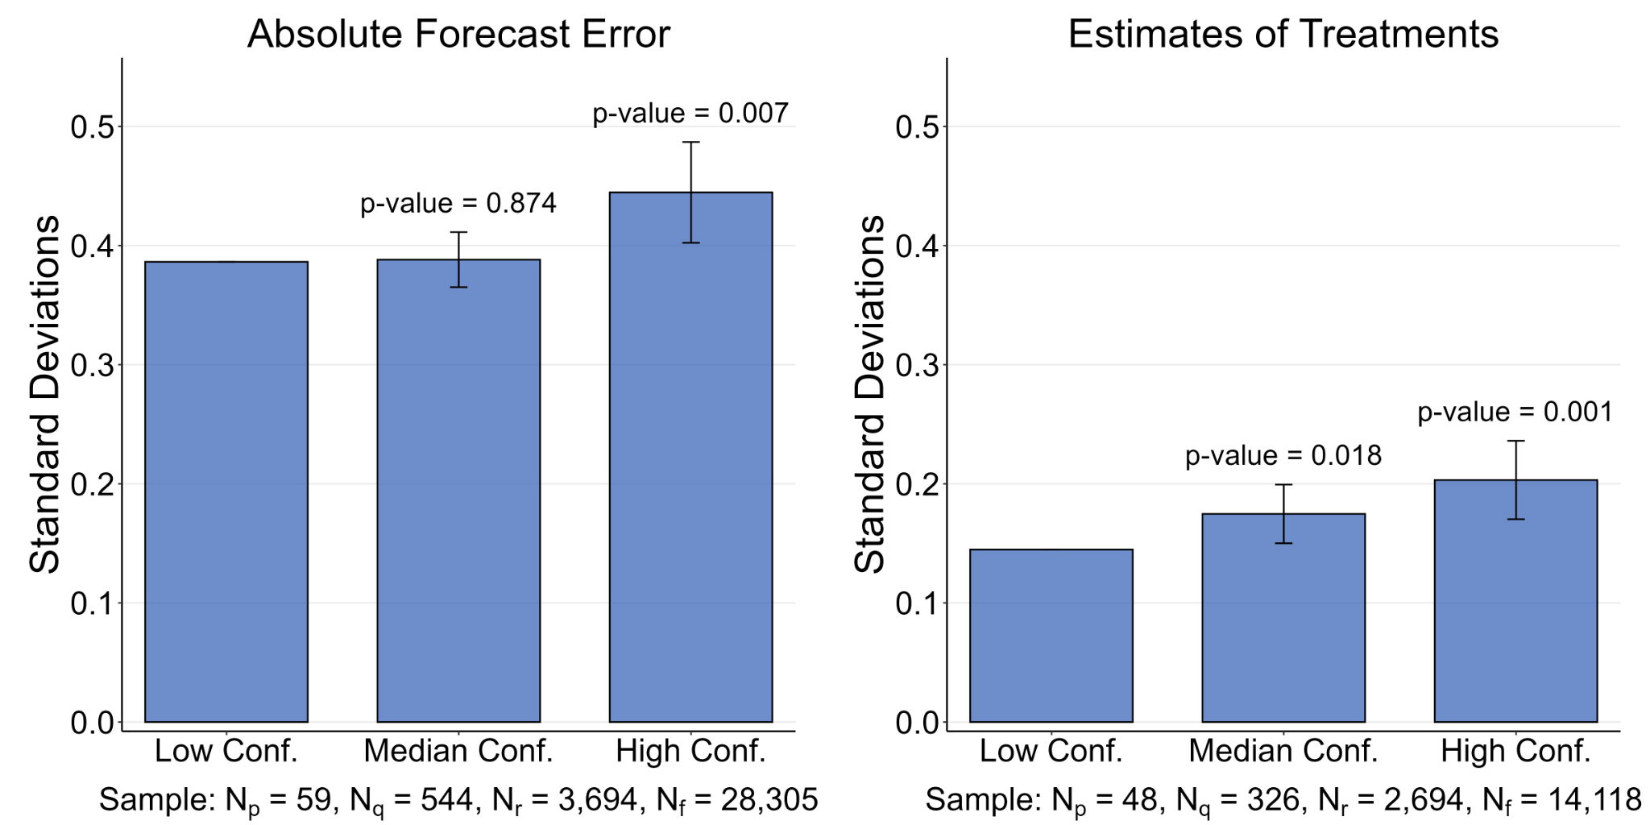
Confidence
Confidence. Do forecasters know how much they know?
Use question on how confident
Split by above-median / below-median confidence

Slide 12
Superforecasters
Are there superforecasters? (Tetlock and Gardner 2016)
That is, are some forecasters more accurate across projects?
Impossible to address so far as no linkage across projects → Use SSPP sample
Sample: forecasters with >=5 projects forecasted (N = 119)
Leave one out procedure:
Leave project j out, take average accuracy in 4 other projects
Plot accuracy in project j as function of the other 4 projects
Measure accuracy as average demeaned error in a project
(Demean by average accuracy in a project to control for difficulty of forecast)

Slide 13
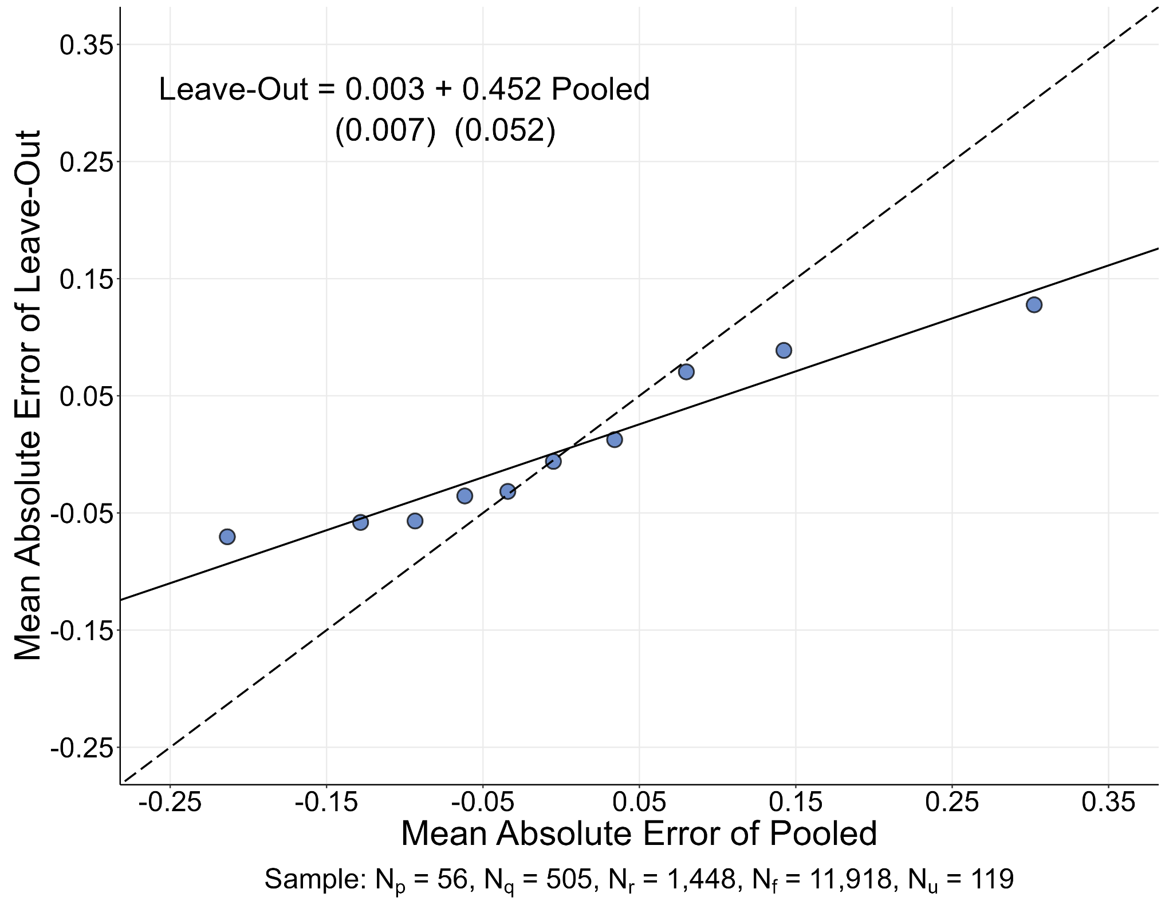
Superforecasters
Superforecasters. Are there superforecasters?
Strong evidence of cross-project accuracy

Slide 14
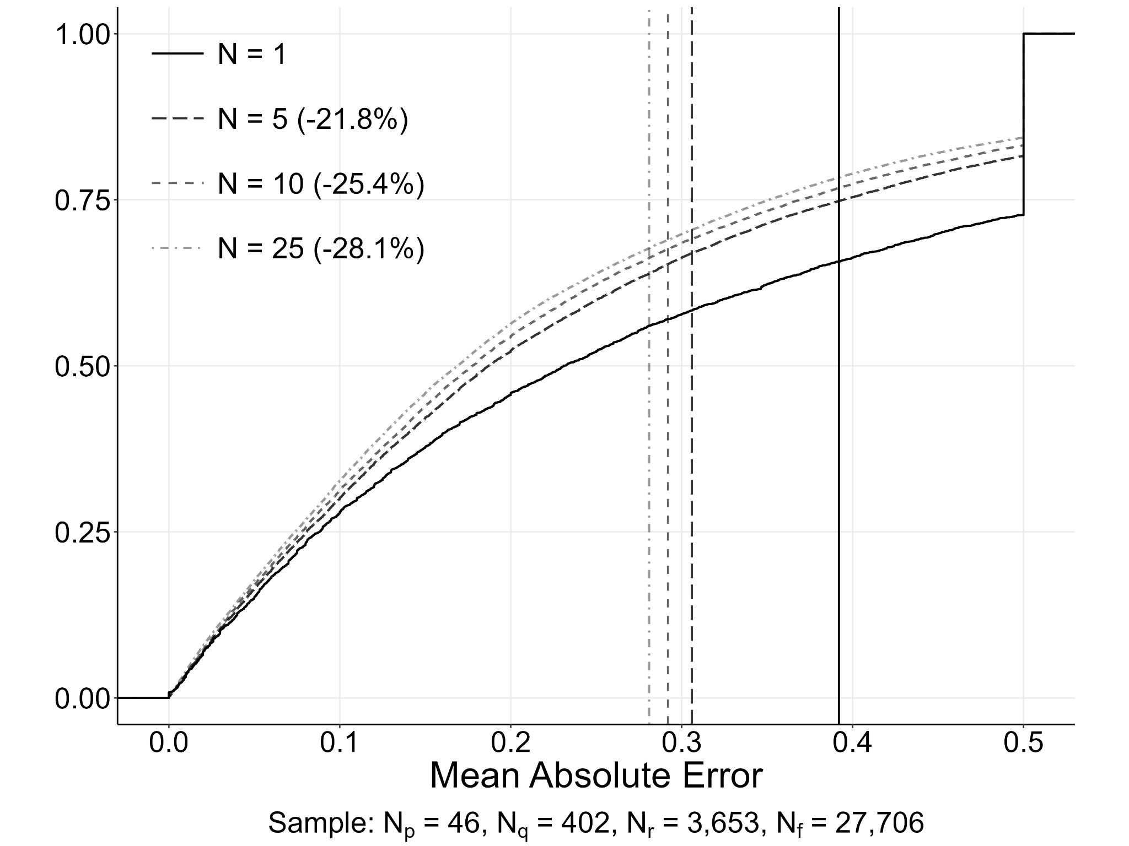
Wisdom of Crowd
Wisdom of Crowds. How much does averaging improve accuracy?
Compare accuracy from N = 1 prediction to N = 5, 10, 25 (s.t. N>=25)
Compare to effect of confidence

Slide 15
Thanks!
socialsciencepredict.org
@socscipredict

